Slide 1
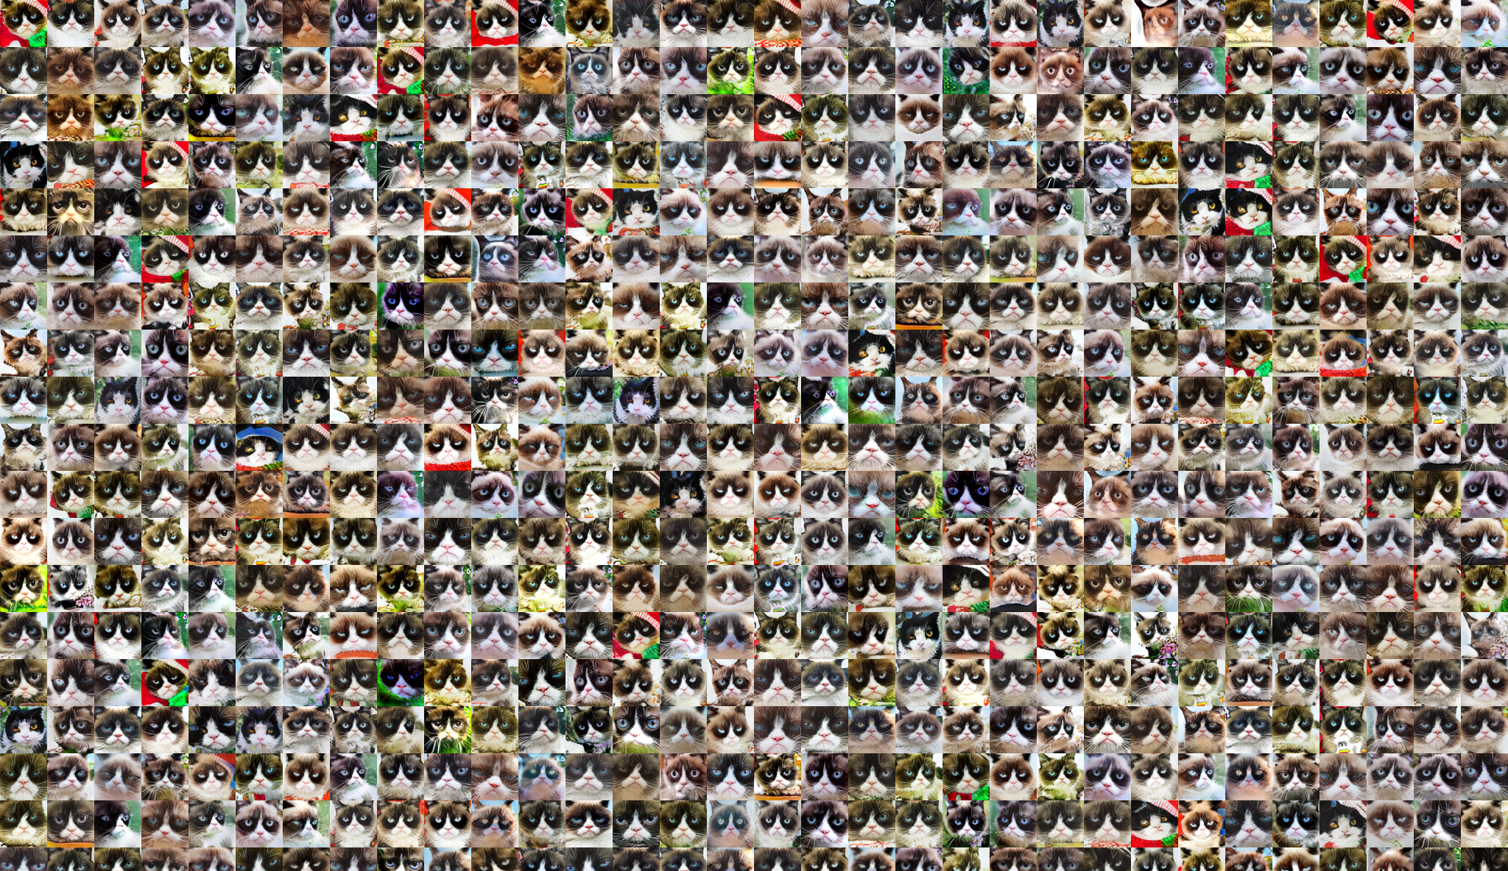
Assignment 3: CatsGAN
Due: 03/24/2021 Wed

Slide 2


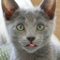
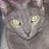



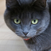
Dataset
Grumpy cats(204)
Russian blue(75)

Slide 3
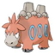


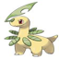
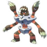

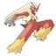
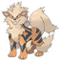




Bonus dataset (for B&W)
Fire
Grass
Water
and many other types….

Slide 4
What we will implement
Model architectures:
Discriminator
Generator
CycleGAN generator
Some training procedure
Logger
Forward backward pass
Other tricks to make GAN work
DCGAN
CycleGAN

